Slide 1

JIRA CAPSTONE
BY TRẦN TUẤN ANH

Slide 2

MỤC LỤC
01
02
03
Log in - Log out - Register
CRUD Project
User Management - User Profile

Slide 3
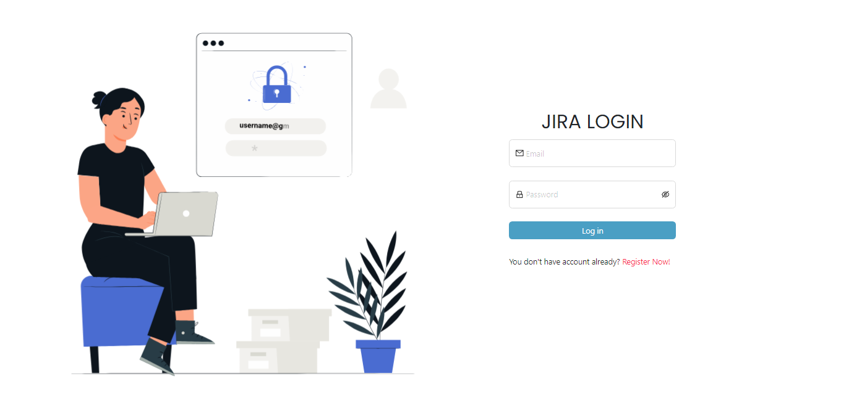

01. LOG IN - LOG OUT - REGISTER
REGISTER
01. Vision
LOG IN

Slide 4

02. CRUD PROJECT
Create project
Project management
Create task
Project detail
Task detail

Slide 5

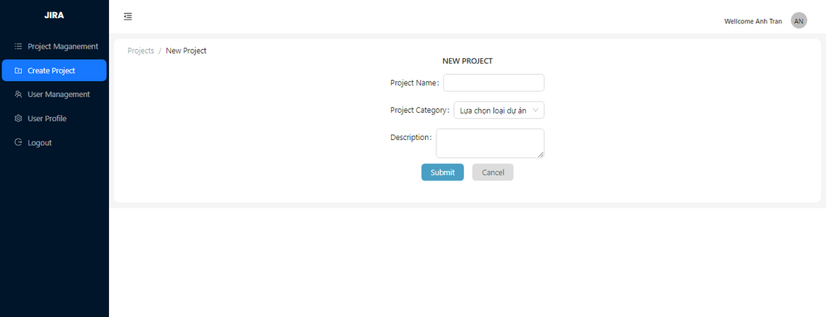
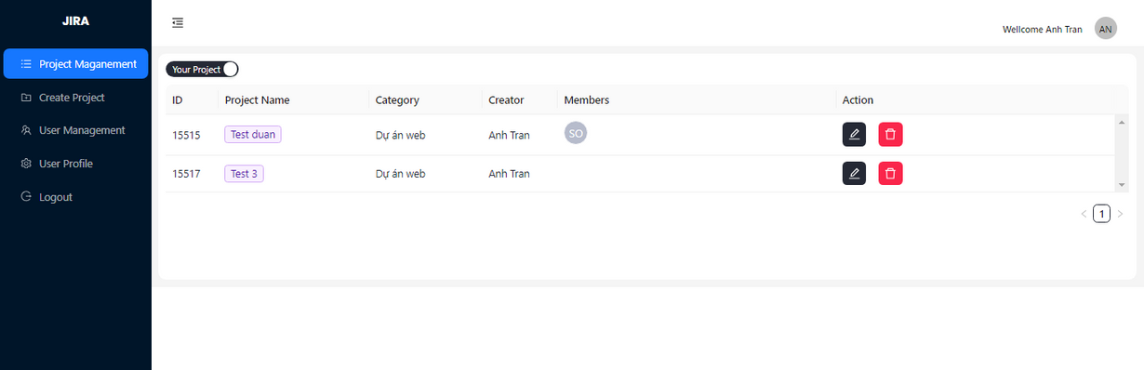
Project management
Create project

Slide 6
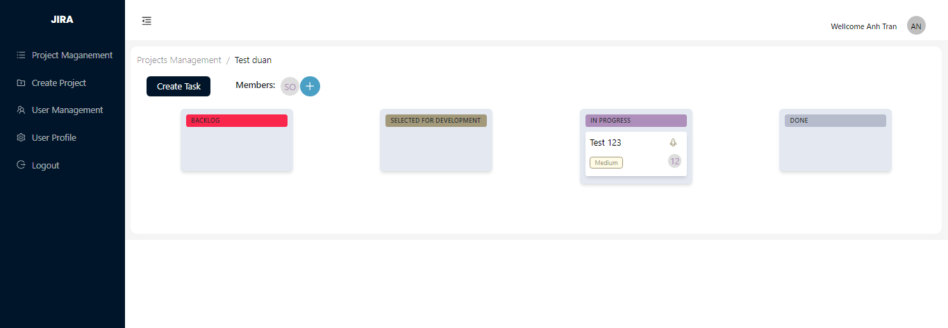
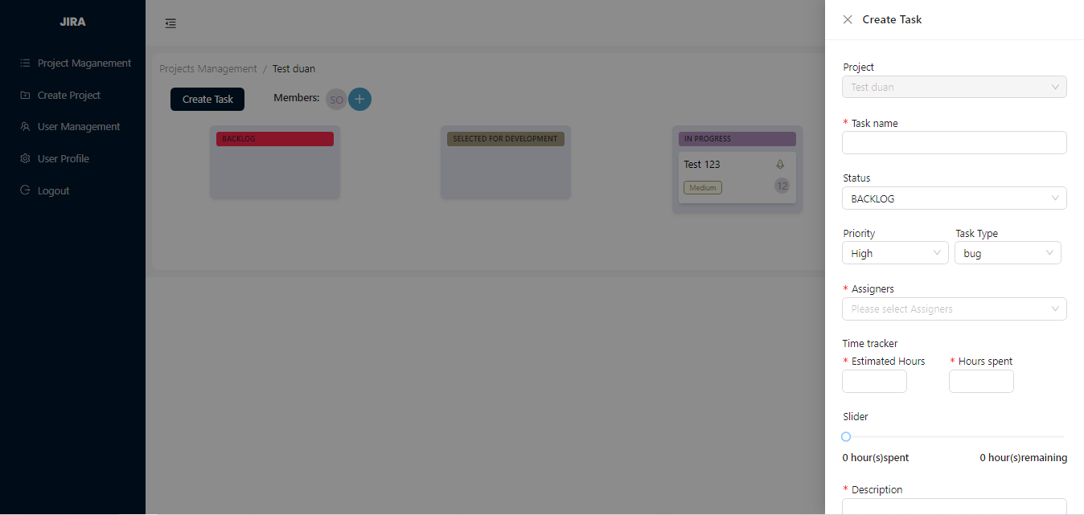
Project detail
Create task

Slide 7

03. User Management - User Profile

Slide 8
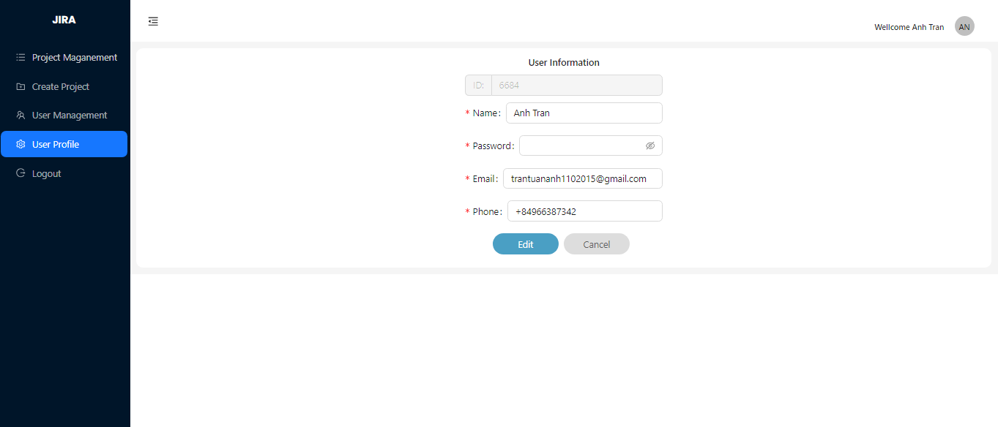

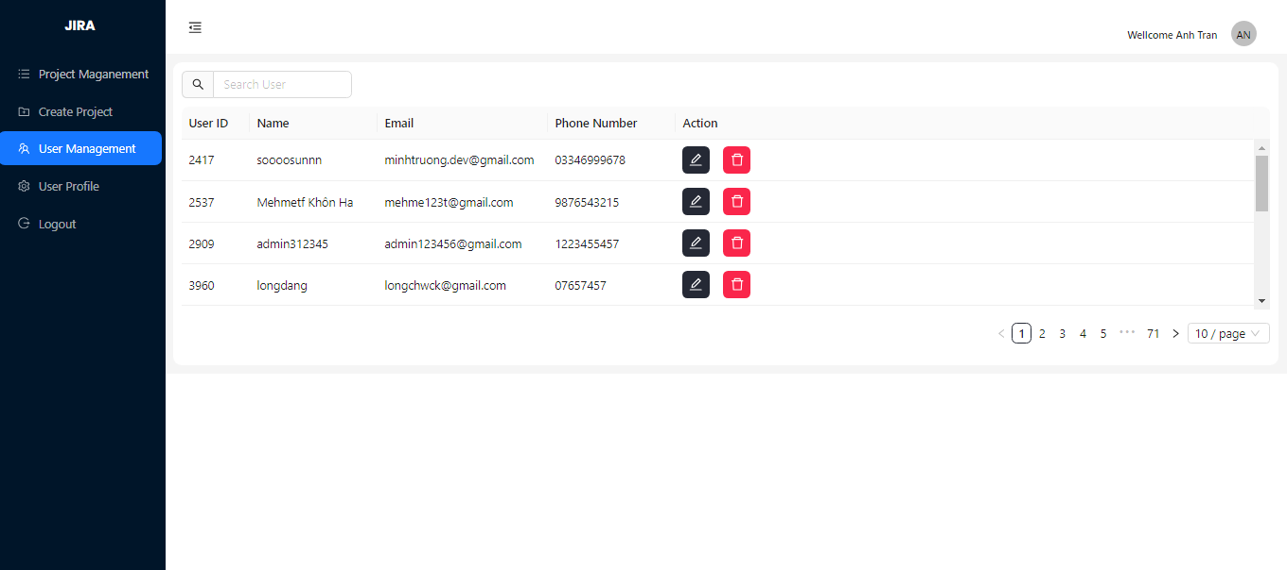
User
Profile
User
Management
01

Slide 9


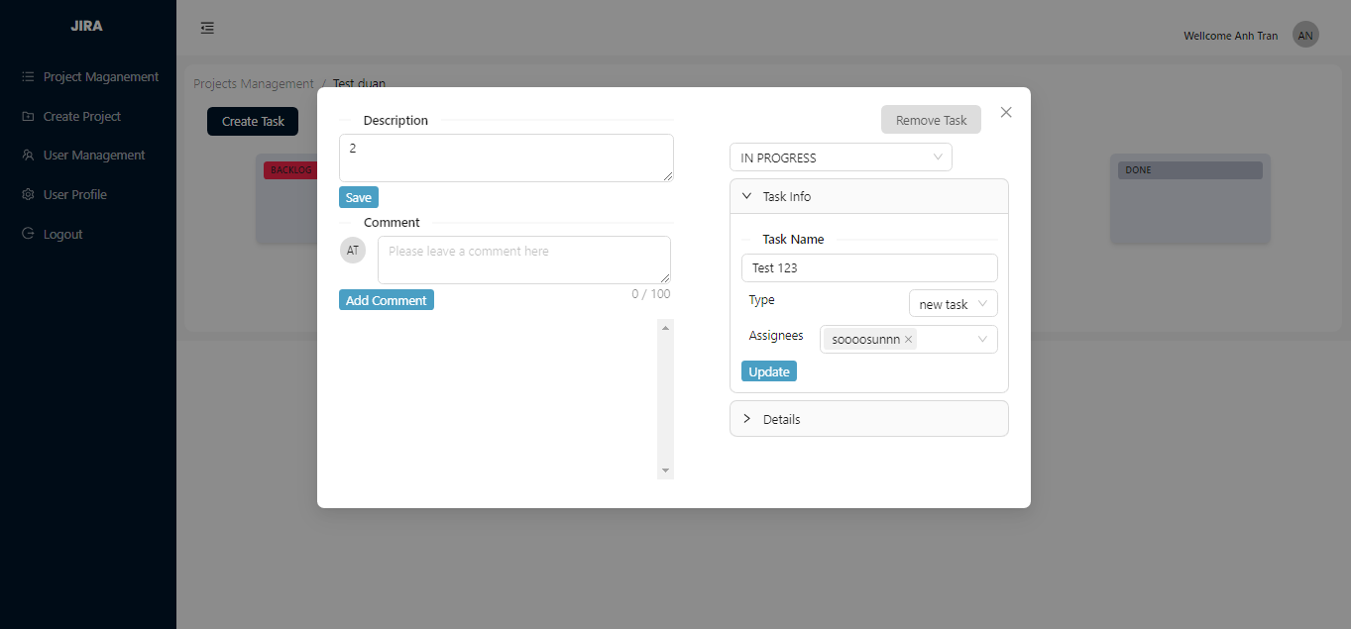

TASK DETAIL

Slide 10


THANK YOU
FOR WATCHING
Nguồn tham khảo:
Stackoverflow, Youtube GreatStack, ChatGPT, Viblo và nhiều nguồn khác.

